Slide 1
Notes:
[WALK-IN VIDEO/AUDIO -- 2:00]
WHO DOESN’T LIKE A GREAT AIR SHOW FLYING DISPLAY?
Gotta love that disclaimer …
“FLOWN BY BOEING TEST PILOTS. DO NOT ATTEMPT”
OK, THEN!

Slide 2
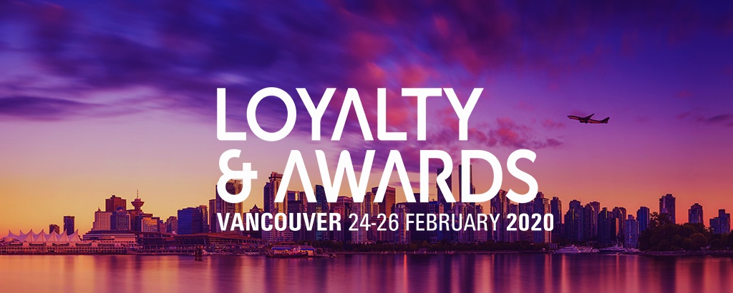
Reintroducing the 737MAX REGAINING TRUST
R.W. Mann & Company, Inc.
February 26, 2020
Notes:
As Ravindra and I corresponded on this presentation,
in mid-2019,
we wondered whether it would amount to a foregone conclusion,
the 737MAX having been re-introduced months earlier…
Well, not exactly…
the long tail of reintroduction delays will only start to sort itself out later this year and likely last into 2022

Slide 3
A Show of Hands, Please! How Many of You…
Notes:
Before we start, may I have a show of hands from the audience…
How many of you…
Drove to the airport to embark on your trip to YVR?
Crossed the street while attending the conference hotel? … Using the crosswalk, right?
Pilot your own aircraft? Have flown on a helicopter tour? Doors-off?
Use an e-Scooter? Go Bungee jumping? Skydiving?
Plan to take a Virgin Galactic sub-orbital hop?
We assume away some fairly risky behaviors, far risker than travel by airline…
Presumably because we believe these to be INFORMED RISKS
It’s worth noting that despite tragedies, in 2019, despite continuing strong global growth in activity, aviation its experienced its third lowest accident rate ever.

Slide 4
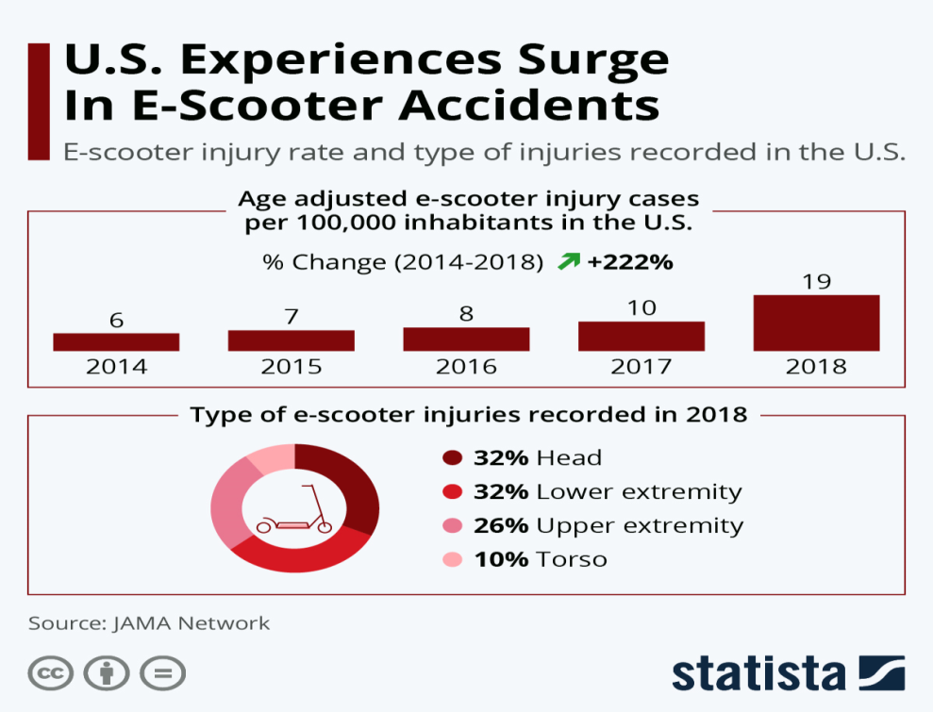
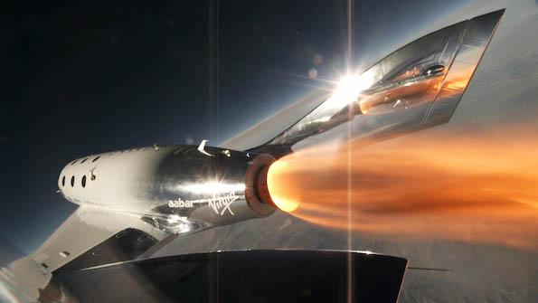
We Choose, and Assume Away,
Some Fairly Risky Behaviors
Notes:
Even though we all say…
and think…
“Safety is Number One”…
Paramount
A binary choice.
Most would rationally think:
If it isn’t absolutely safe, I’m not doing it,
Or riding one, or flying on it…
…
BTW, FAA explicitly makes no guarantees of the safety of EXPERIMENTAL commercial space flight
So, bon voyage!

Slide 5
Full Disclosure
As an aero engineer, I differed with the original 737MAX ‘single-input’ design, how it was communicated, and brought to market
But I agree with how Boeing has modified it
I spoke at length with 737MAX line pilots and experienced SIM sessions illustrating how original and evolved systems perform
I would have gladly flown JFK to Vancouver on a 737MAX, then or now
Notes:
As an aeronautical engineer, I differed with the single-input flight control system Boeing originally designed … COMMUNICATED… and brought to market
But I agree with how they modified it
(And should have designed it from the start -- if only to be more transparent and forgiving in use, where airmanship and maintenance of jet transports are in the relatively early days)
I have spoken at length with 737MAX line plots from several airlines and experienced SIM sessions illustrating how the original and evolved systems perform
I would have gladly flown JFK to Vancouver on a 737MAX

Slide 6
THE 737MAX REINTRODUCTION: REGAINING TRUST
Regulatory, airline, traveler TRUST
Equipment, operations, marketing TRUST
Emotions and views about air travel safety
Can these be addressed rationally?
Notes:
The core issue underpinning the 737MAX re-introduction is TRUST
Of ALL the parties involved
TRUST of the regulator, FAA
TRUST of the equipment
TRUST of the operating airlines, maintainers and flight crews
When that work is done…
Restoring frequent/corporate/broad market TRUST is going to require a comprehensive campaign…
Of equipment modifications, regulatory review and action, airline training and procedural changes,
And throughout that process, effective COMMUNICATIONS from each of the TRUST parties
Can emotions and CONCERNS be addressed rationally?
Can TRUST be restored?
I will offer you the views of an aeronautical engineer, airline fleet planner, loyalty marketer, and airline industry analyst, who, like you, often flies as a passenger, choosing both airline, and equipment type

Slide 7
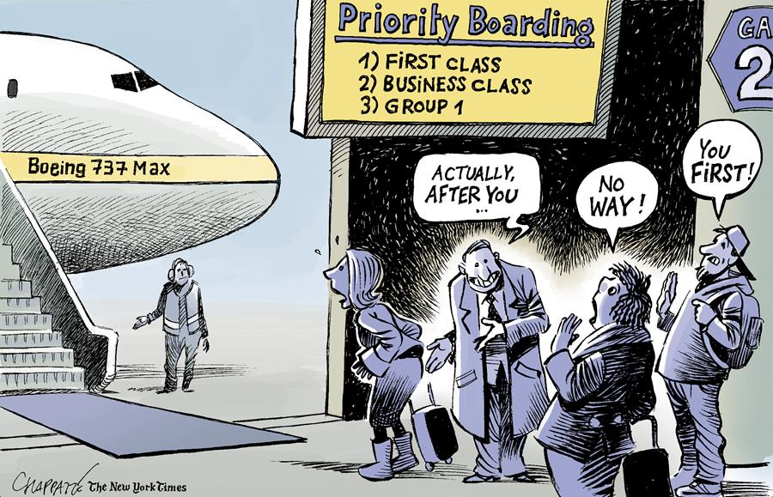
Notes:
THIS of course, is what the industry wants to avoid…
WITH ANY EQUIPMENT OPERATED
Mitigating AVOIDANCE when
LOOKING
BOOKING
BOARDING
and especially
FLYING

Slide 8
Rational vs. Empirical Views
Are we dependent upon first-hand sensory experience in our effort to gain knowledge?
If so, innovation quickly becomes a ‘Catch 22’
A hybrid approach informs how to re-establish TRUST, move forward, accelerate 737MAX acceptance, mitigate 737MAX avoidance
“TRUST, and VERIFY”
Notes:
OK, so what are the two, POLAR OPPOSITE perspectives here?
Rationalists (the analytical) believe concepts and knowledge can be gained independently of sensory experience
Empiricists (the SHOW ME group) believe that sensory experience is the ultimate and ONLY source of all concepts and knowledge
HOW DO WE BRIDGE THAT GAP?
WHEN WE CANNOT CURRENTLY FLY AND EXPERIENCE THE MAX?
WHEN NO ONE OUTSIDE BOEING TEST and AIRLINE FERRY FLYING HAS?
Consumer expectations are shaped by every interaction.
The most recent experience influences expectations for the next.
WITH THE MOST RECENT EXPERIENCES BEING TRAGIC, HOW DOES THE MAX RECOVER?
To paraphrase Ronald Reagan, “TRUST, and VERIFY”

Slide 9
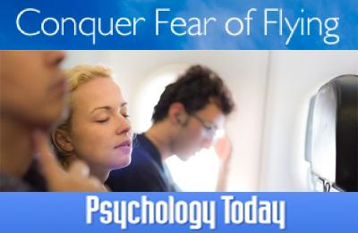
Notes:
Important to remember that there is still a large “Fear of Flying” remediation industry…

Slide 10
Can the Market’s Views of TRUST (Safety) Be Swayed?
Baseline
PROS: vanishingly low airline accident rate
CONS: 2 accidents, corp comm, social media
A rational analytical framework
With an empirical frame of reference
Prior experience informs the strategy for ‘evolved’ 737MAX reintroduction
But not how rapidly the market will respond
Notes:
Despite ‘fear of flying’, the industry is historically safe – 2019 was aviation’s third-safest year, worldwide [2017 was safest]
The 737MAX rational analytical framework
The aircraft certification process is independently judged robust
Perception of aviation safety is mandatory, binary, not ‘discountable’
Yet we face, tolerate and assume away far greater risks in every day life than on any airline-operated aircraft
The evolved 787 empirical frame of reference (and other priors) is helpful
2014: Grounded for four months, after battery/charging system fires
Today: Global fleet of 936 aircraft, 400+M customers flown; 1.9M revenue departures;
No reoccurrence; Aircraft has performed exactly as originally intended, now, arguably, preferred for mission
787 and prior experience informs path to 737MAX reintroduction
but not the market’s response rate/speed -- especially in the social media maelstrom era

Slide 11
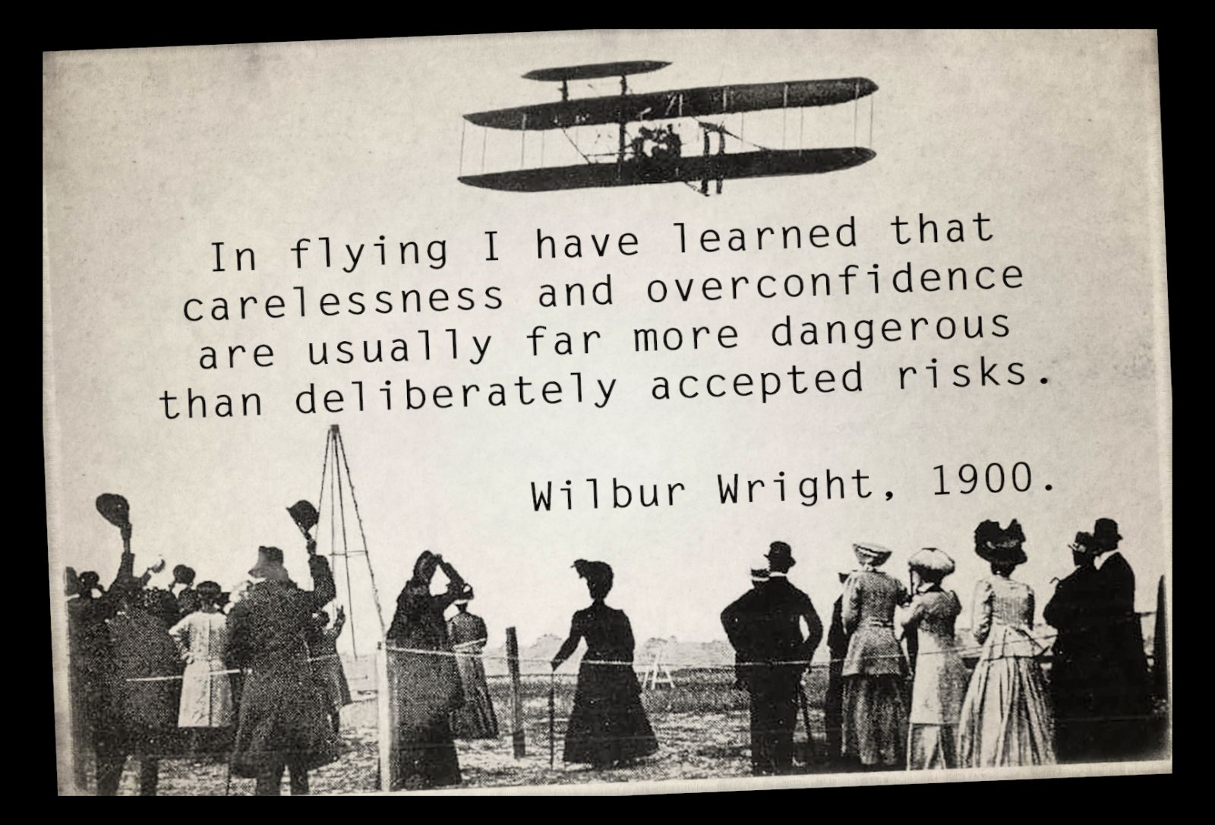
Notes:
This is from a note from Wilbur to his father, in 1900
Three years before his historic man-powered flight at Kitty Hawk
Four years after the death of Otto Lilienthal,
who pioneered glider flight in the 1890s,
and who had died in a glider accident four years earlier
An early expression of why Safety is everyone’s job

Slide 12
Regulatory TRUST
MAX derives from a globally vetted design
Aircraft use case continues to change, globally
Accidents forced change to design/oversight
Created a thorny communications issue
For Boeing
For the FAA
Notes:
So we have TRUST issues, and that is DESPITE
737MAX being derived from globally federated/vetted design with over 200 million hours of safe operating experience
SOME ASPECTS of the 737MAX debacle inarguably derive from airline performance, equipment, use-case issues
SO WE HAVE DESIGN AND REGULATORY OVERSIGHT ISSUES
AIRLINE CUSTOMERS WHO OPERATE THE NG WANTING MINIMAL CHANGES WITH 15% IMPROVED OPERATING ECONOMICS
Changing global technical demographics of Transport Category aircraft should have driven greater consideration of cockpit and flight control systems design, data presentation, training and maintenance programs
Ultimately, however, HOW TO MANAGE REINTRODUCTION of the 737MAX has become a communications issue
Frustrated to some extent by Air Accident Analysis ‘Party Rule’ (and US DOJ)
Focusing on the substantive and actionable vs. sensational
Manufacturer worked the problems, silently
Airlines continue to work (and be frustrated by) ROLLING 330 day RES/90 day CREW scheduling windows, training requirements
UNABLE TO RESPOND CANDIDLY OR TRANSPARENTLY to Media and Customer demands for instant, full disclosure
BUT WITH NO LIMIT ON COMPASSION, except that imposed by Corporate Counsel and Insurers

Slide 13
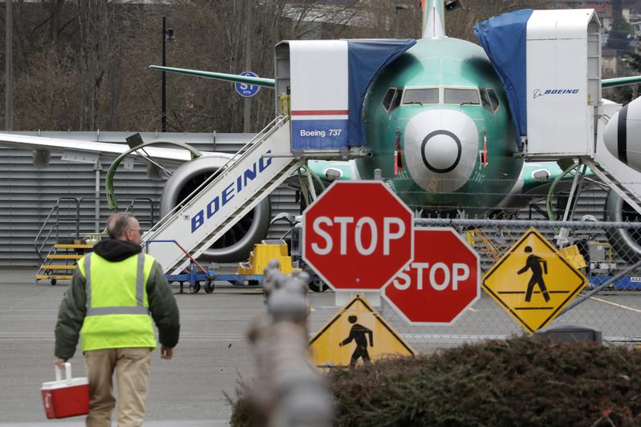
Notes:
How does Boeing green-light a grounded program with all constituencies
Regulators
Airlines
Customers
And not least,
the Social Media maelstrom!

Slide 14
Equipment TRUST
Rationally: a single, global, level of safety
All aircraft evolve over their service lives
From delivery to delivery
From delivery to retirement
Empirical evidence: post-grounding safety
Notes:
First, airlines and WE must trust the equipment…
Regulators promote ‘a single level of safety’ … globally … independent of equipment type
All aircraft evolve in service –
737MAX hardware and software are based on equipment with 200 million hours of in-service experience – the 737NG
737MAX flight control software has evolved to be even safer than at EIS
Airlines embrace the equipment as empirical evidence shows post-grounding safety improves

Slide 15
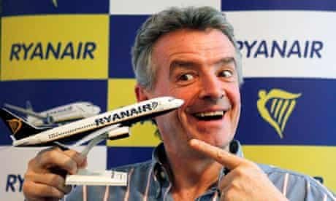
Notes:
Here’s a guy who trusts the MAX,
and wants to double-down on the MAX-10

Slide 16
Airline TRUST
Airlines know and trust their equipment
Airlines maintain constant dialogue
With crew, customers, corporate travel arrangers
Airlines are best positioned to evoke trust
Have the direct customer relationships, targeting
Boeing providing content assistance, support
Notes:
Airlines know the 737MAX configuration they originally inducted, and the changes (hardware, software, training) made prior to re-introduction
Airlines know which crews, individuals, corporate customers/travel arrangers flew on the 737MAX during the years beyond its initial EIS
Airlines have a constant dialogue with crew, elite individual, corporate customers, travel arrangers on a variety of issues
Airlines are best placed to continue that dialogue about the 737MAX, with Boeing content assistance
Airline TRUST will not be difficult to re-establish,
Especially as Greater consideration is being given to the emerging use-case – NOW, MANDATING SIM TRAINING, FOR EXAMPLE
A global aviation oversight, training, operations and maintenance environment
Regulators and Airlines will accept the evolved 737MAX
AIRLINES WOULD LIKE TO GET THE AIRCRAFT BACK INTO OPERATION ASAP
What about Customers?

Slide 17
A MAX-less Summer 2020? Typical ‘Rolling Delay’…
Graphic: CNBC (14FEB2020)
Notes:
As of NOW, the MAX appears likely to be re-certified in JUNE
(for a RETURN TO SERVICE in late Summer 2020, following pilot SIMULATOR TRAINING)
Appears, because it has been a roller coaster for airlines attempting to file schedules, train crews…
STAY TUNED…
MUCH AS AIRLINES HOPING TO OPERATE THE MAX ARE DOING

Slide 18
‘Best Customer’ TRUST
Loyals trust their airlines – usually
Social media firestorm results from failures
Loyals will accept and trust the 737MAX…
‘Best Informed – Most Accepting’ + Experience
737MAX will rapidly gain public confidence
At 10x the 787 rate, considering fleet size, mission profile, and number of customers flown per day, social media acceleration and ’halo’
Notes:
How do we generate CUSTOMER TRUST?
Best Customers TRUST, but also act out
Dr. Dao… Emotional Support Animals… cancellations…
Even protracted delays can evoke a social media firestorm
Empirical evidence illustrates quick, post-grounding acceptance
400+ million customers have eagerly flown and prefer the 787… that evolved, post-grounding
Hundreds of millions flew on evolved DC-10, Electra, Comet… post-grounding
Best Customers will willingly fly on the evolved 737MAX
‘Best Informed – Most Accepting – Most Likely’, others after a period of review and introspection – which can be accelerated
Evolved 737MAX will accumulate public confidence at 10x the 787 rate
Considering fleet size, mission profile, and customers flown per day

Slide 19
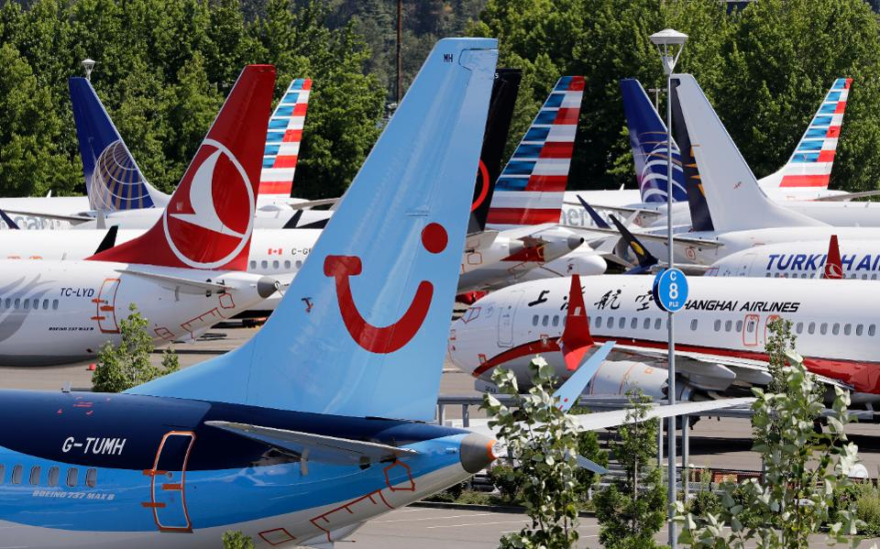
Notes:
THE TRUST STAKES ARE HIGH
79 AIRLINES HAVE ORDERED 5100 MAXes
INCLUDING THOUSANDS IN DEVELOPING MARKETS
WHERE THE MAJORITY OF CUSTOMERS ARE NEW TO AIR TRAVEL

Slide 20
What About Broad Market TRUST?
Pareto Principle/The 80:20 Rule/’The Vital Few’
Loyals represent 20% of passengers, 80% of revenue
Informed ‘loyals’ trust, trial, accept, advocate/LTR/NPS
Will the broad market of 80% ‘infrequents’ follow?
Boeing broad market communications should supplement airline-targeted communications
Airline use-case demographics drive change
Evolutionary and generational changes
Manufacturer and regulator research leadership
Notes:
SO DEVELOPING BROAD MARKET TRUST -- NOT JUST BEST CUSTOMERS -- IS CRITICAL PERHAPS THE BIGGER CHALLENGE
IN DEVELOPED MARKETS… The 80:20 Rule on Passengers:Revenue (and Revenue:Passengers) on NPS / LTR
When airlines, crews, the 20% frequents (80% revenue) and arrangers trust, will the 80% broad market (20% revenue) follow?
Regulators, manufacturers and airlines are leaders
Safety is everyone’s job, which is why aviation is proving increasingly safe, worldwide
Much of traditional and social media reporting, alarm, and ‘echo chamber’ has been passed along by and among less technically aware, occasional, and infrequent customers
While tragic, the facts belie most alarmist reporting and commentary
A Boeing broad market communications strategy will supplement airline-targeted elite/corporate/travel arranger/crew communications strategies
Airbus and Boeing are leaders in raising the state of global industry safety that recognizes the changing technical demographics of where, how and by whom their aircraft are operated, via
Evolutionary changes to current and future aircraft designs
Leadership in Man-Machine Interface, Cockpit Design, Data Presentation, Feedback Systems, and Collaborative Safety Reporting Systems
for the Evolving Global Aviation Market Environment
Leadership in environmentally friendly aircraft designs whose use reduces aviation’s carbon signature

Slide 21
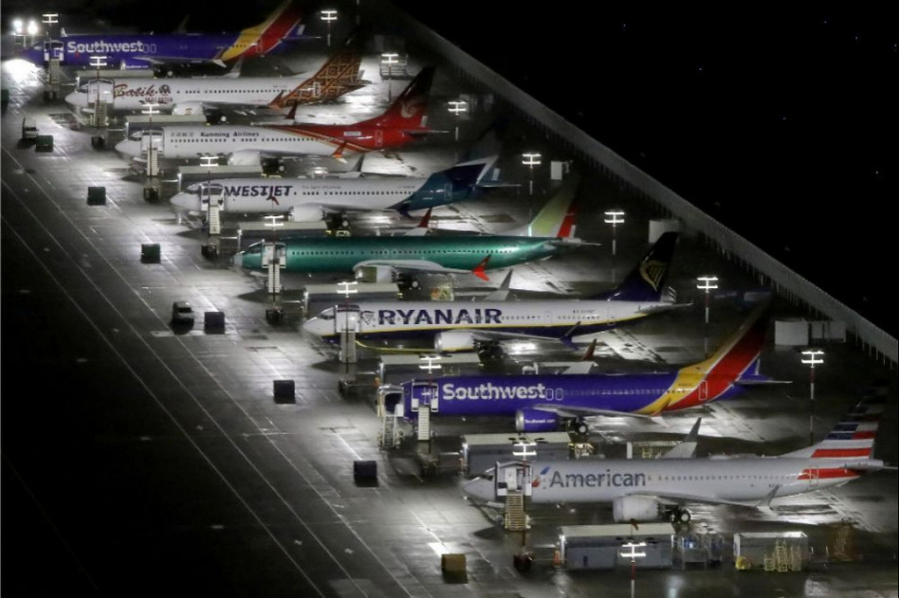
Notes:
MAXes as far as the eye can see…

Slide 22
Should Airlines Leverage Loyalty?
Could… but except for targeting, should not
Airlines can -- and must -- micro-target at scale
Perception/reality of safety is #1, essential, binary
Industry-wide, an unprecedented, expensive, but necessary informational and experiential effort will be underway
to ensure crew confidence
to accelerate customer re-trial/acceptance/preference
Notes:
Now, as part of a comprehensive Re-Introduction Communications plan…
THE MONEY QUESTION -- Should airlines leverage loyalty to re-introduce the MAX?
They could ….. but ….. except for the programs’ value in targeting, they should not
GOING BACK TO THE rational analytical framework
Perception/reality of safety is #1, essential, binary
Not discountable or ‘incentivizable’ by price, elite qualifying miles, or points
WOULD YOU PAY 20% LESS FOR AN EXPERIENCE 20% LESS SAFE?
IS THERE A PRICE ELASTICITY WITH RESPECT TO SAFETY?
At re-introduction, the baseline is the evolved 737MAX
Regulators have re-certificated it, Airlines have re-inducted it, Crew have endorsed it
Airlines have performed ‘Confidence flying with staff and invited guests’
Confidence Flying guests to include elite customers, corporate travel arrangers
THAT IS THE LOYALTY LEVERAGE – Targeting best customers to become influencers
for trial , acceptance, and word of mouth report of experience and referral
his will; be an unprecedented, unusual, expensive, but necessary
to ensure and accelerate crew and customer buy-in, towards preference

Slide 23
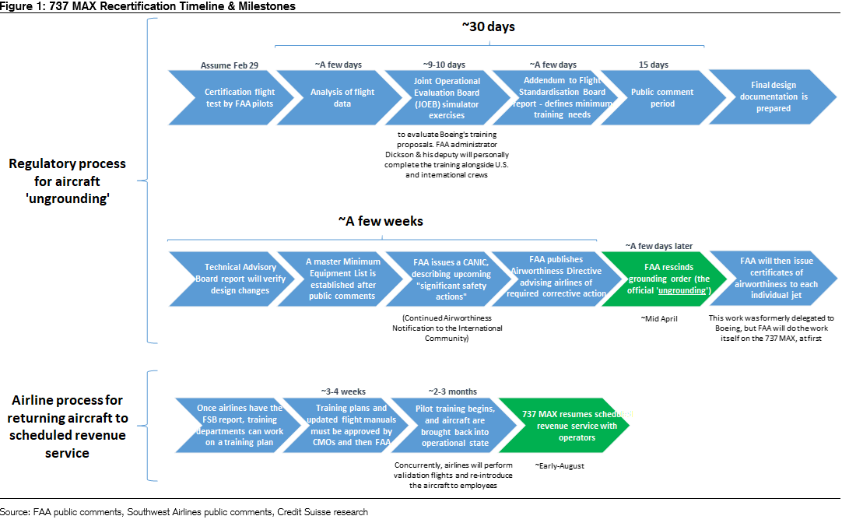
MAX RTS Dominated by Airline Process
Source: FAA, Boeing, Credit Suisse
Notes:
The MAX Return To Service (RTS) Is Dominated by Airline Process
Maintenance, Crew Training, Confidence Flying, Scheduled Service
As Much as 3-4 Months if Taken as a Whole
As little as 1-2 Months if Performed in a Staged Manner
THAT TIMELINE ILLUSTRATES THE UNPRECEDENTED AIRLINE TRUST CHALLENGE

Slide 24
Airlines Should Leverage Social Media
Influencer #MAXtags
#IFlyTheMAX #ICrewTheMAX #IMaintainTheMAX
#IChooseTheMAX #IFlewTheMAX
#MakeMineA737MAX
#ToTheMAX
And On The Re-Branding Question… A MAX By Any Other Name Is…
#JustAnother737
#StillTheMAX
Notes:
While holding short of loyalty incentives,
airlines should use the time in hand after FAA recertification and before RTS to lead with and leverage social media
Confidence Flying with #MAX #TAGS
#IFlyTheMAX #ICrewTheMAX for Line Pilots and Flight Attendants
#IMaintainTheMAX for AMTs
#IFlewTheMAX for Guest Passengers and Staff
And about the re-branding/re-naming talk?
Let’s face it, a MAX by any other name is…
#StillTheMAX and #JustAnother737 like the 10,000+ already delivered
And the 5100+ deliveries and orders for a 15% more efficient aircraft
Still the MAX

Slide 25
Summary: Reintroducing the 737MAX
Airlines best positioned to target, create, continue elite/corporate/travel arranger dialogue, with Boeing content assistance
Best Customers and Social Media influencers will pave the way for 737MAX return to service
Boeing best positioned to create/continue broad market dialogue on MAX, global safety leadership in the evolving airline environment
Air travelers assume away far greater risks every day than they will ever experience on airline-operated aircraft
Notes:
Airlines best positioned to create/continue elite/corporate/travel arranger dialogue, with Boeing content assistance
Boeing best positioned to create/continue broad market dialogue on design evolution, global safety leadership in a changing global airline operating environment
Social Media INFLUENCERS will pave the way for the broad market’s acceptance as the 737MAX returns to service
Air travelers assume away far greater risks in every day life than they will ever experience on airline-operated aircraft
This is NOT to forget that customers SAY
they prefer more environmentally sensitive travel options
Using a ‘green filter’, the 737MAX responds to that desire
with a 15% more fuel-efficient, 15% lower carbon emissions signature
Greta Thunberg should approve of the MAX…

Slide 26
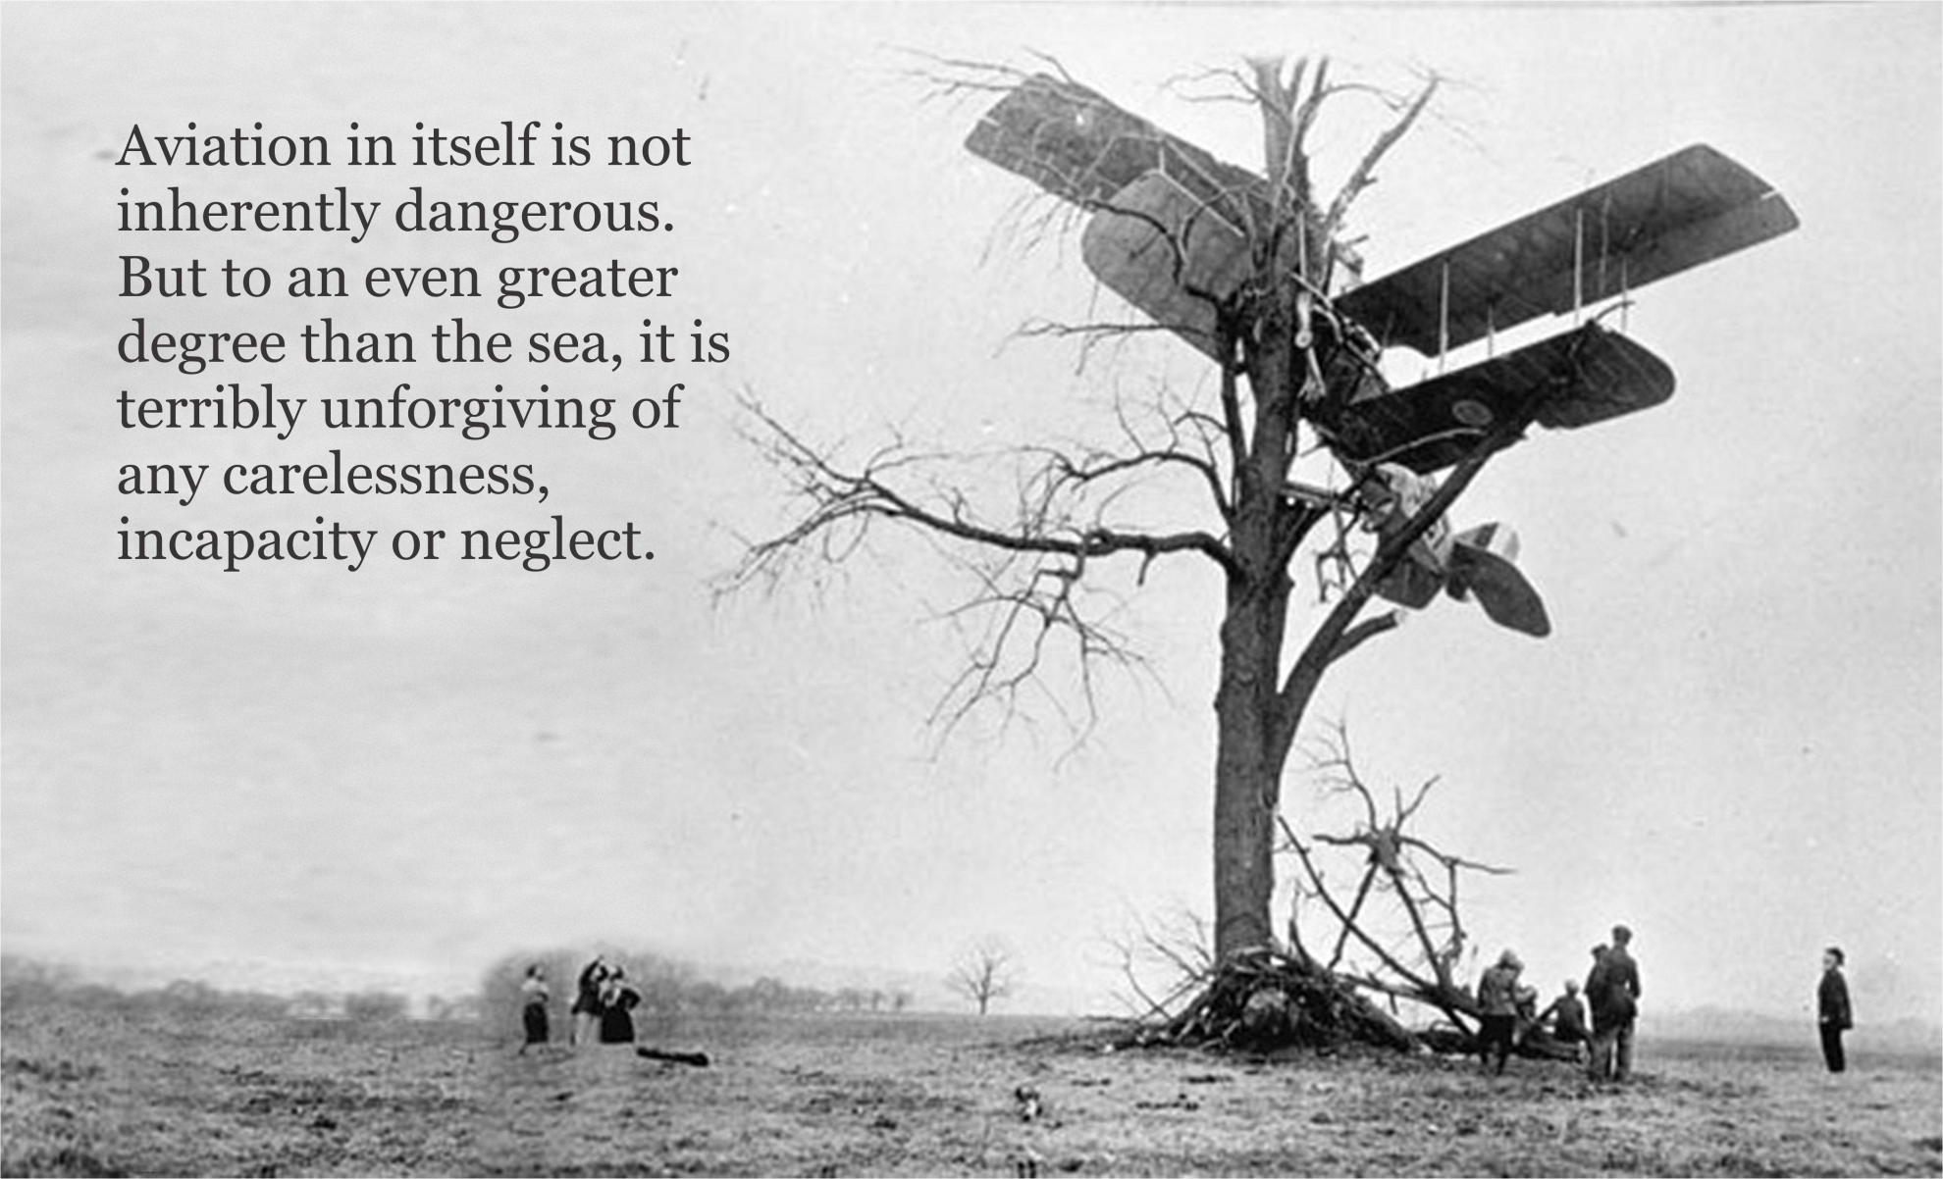
Notes:
Captain A. G. Lamplugh, a British pilot from the early days of aviation,
and later a British Aviation Insurance Group executive, once famously said:
“Aviation in itself is not inherently dangerous.
But to an even greater degree than the sea,
it is terribly unforgiving of any carelessness,
incapacity or neglect.”
True then, today, and always will be…
…
BTW, the alternative CAPTION for this photo is:
“There was only one tree,
and you had only one job…”

Slide 27
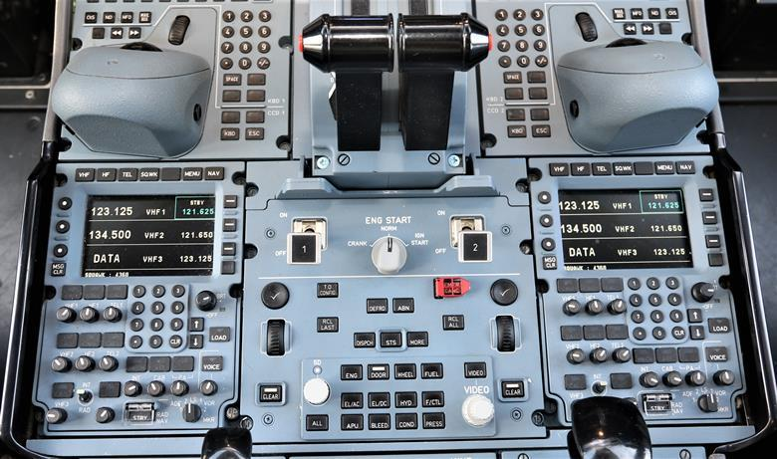
‘The Pepsi Syndrome’
“Airbus and Rolls-Royce are investigating incidents in which two A350s experienced uncommanded in-flight engine shutdowns after drinks were spilled on the cockpit pedestal.”
Notes:
On the topic of carelessness, those of you of a certain age may remember the subject SNL skit…
About nuclear reactor control room safety practices.
Which also describes a more recent example of carelessness…
Among the reasons cup-holders are an important design feature…
The ruling?
“A350 cockpits must have ‘liquid free’ zone after spill incidents”

Slide 28
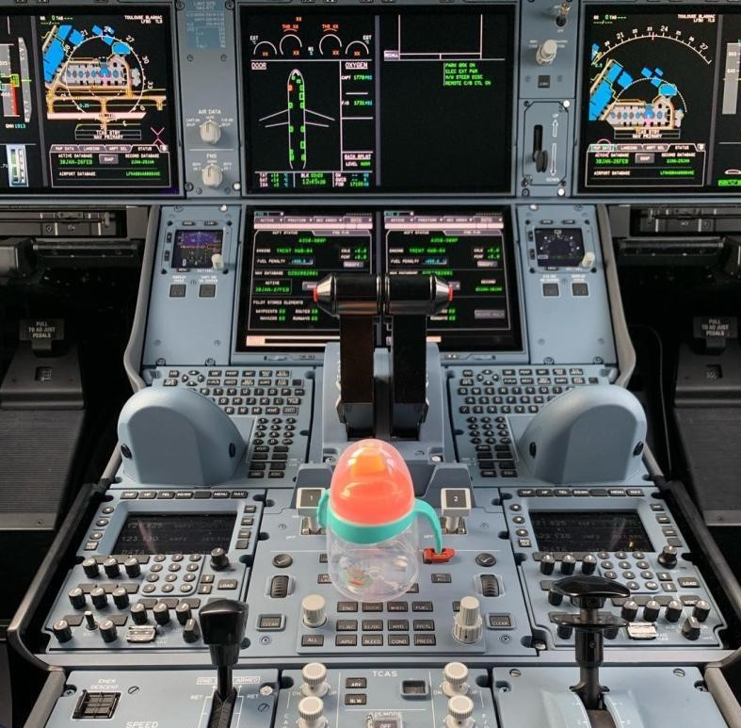
The Remedy
Notes:
$6000 each, with the FAA TSO and STC

Slide 29
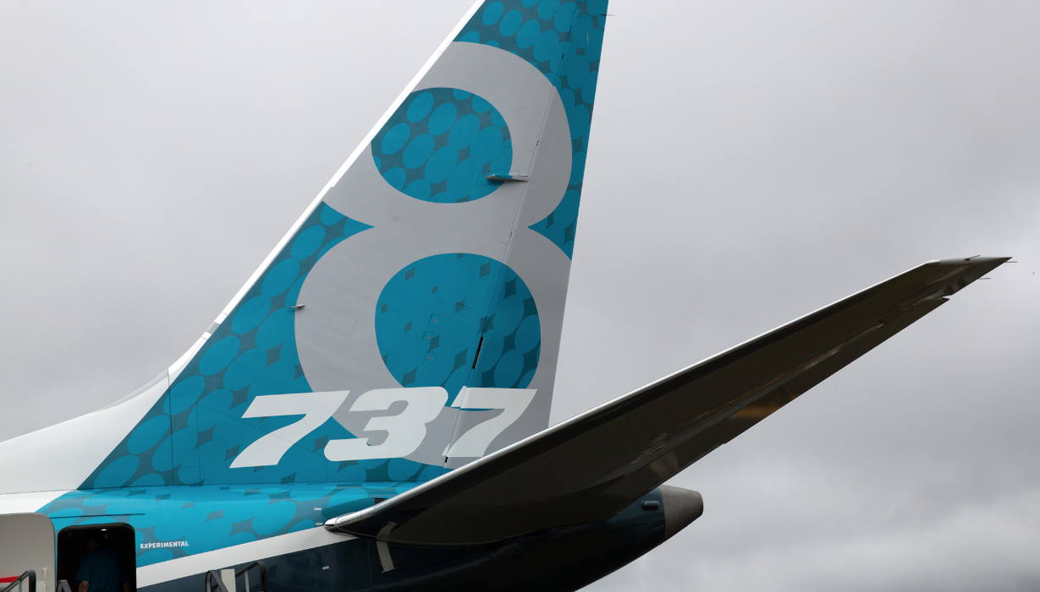
#WillYouFlyTheMAX?
Notes:
So, careful where you place your tea cup, and let’s open it up to QUESTIONS
WHO IS READY TO GO FLY THE 737MAX?

